Slide 1
RYAZ Training 2K19
By – Nandini Prashar

Slide 2
About The Amazing Little Journey Till Now...
It has been great to be working with the entire RYAZ team and I thank everyone to help me in my work and making me feel extremely comfortable.

Slide 3
What have I learnt..
Since my training was in web designing, I worked with HTML, CSS, Bootstrap, and JavaScript.
In addition to this, I learnt various other new things like uploading my work on GitHub, sharing the code on Codepen.
Above all this, I actually learnt what teamwork is. (All thanks to team RYAZ)

Slide 4

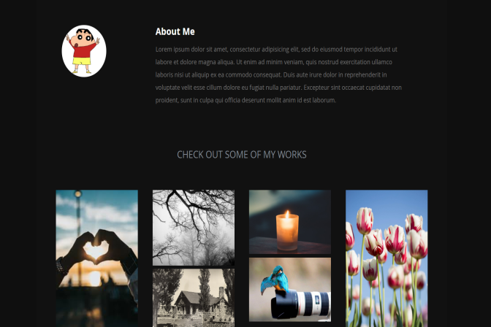
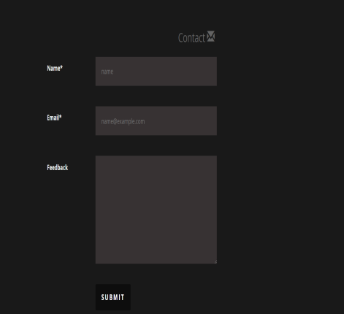
Training Task 1 (Web Page Using JS)
https://nandiniprashar.github.io/photography/

Slide 5
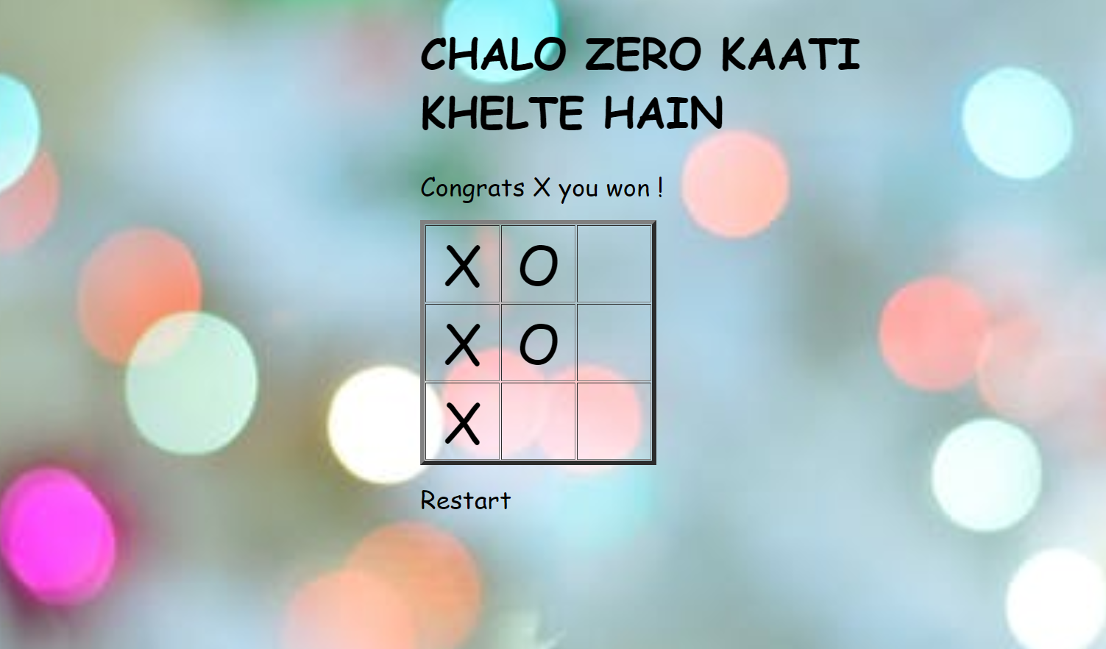
Task 2 (Tic –Tac- Toe)
https://nandiniprashar.github.io/tictactoe/

Slide 6
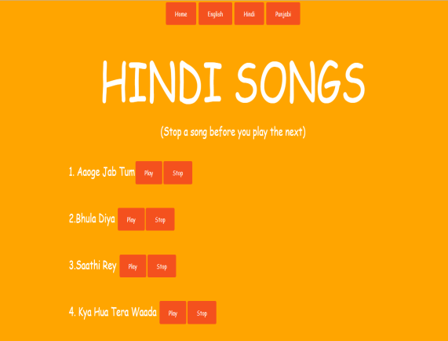
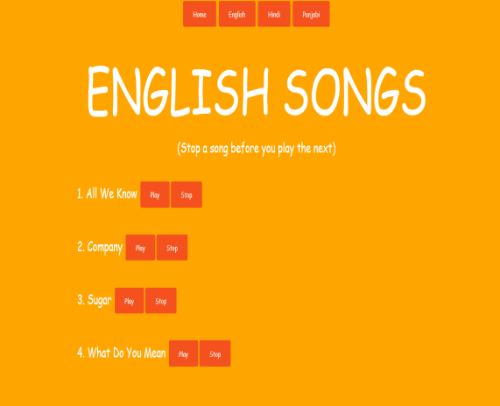

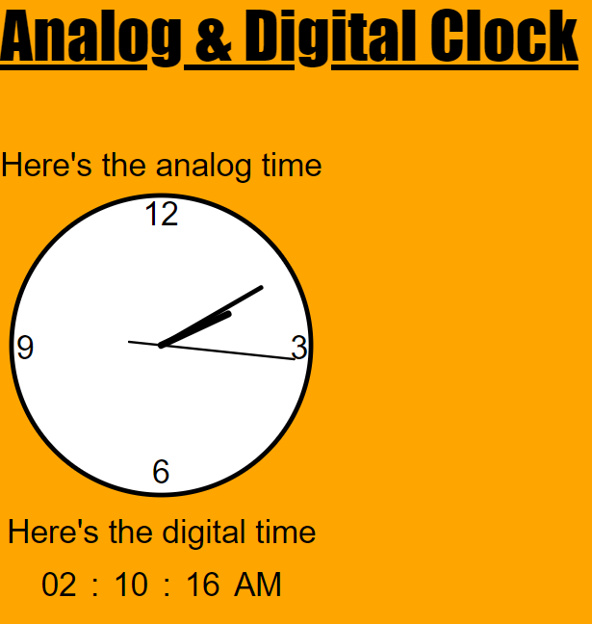
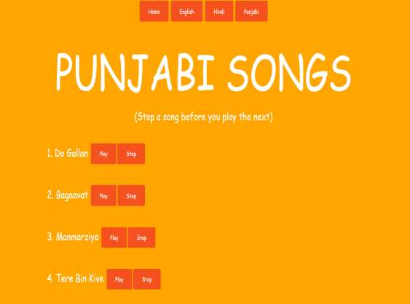
Other practice tasks
https://nandiniprashar.github.io/music/
https://nandiniprashar.github.io/clock/

Slide 7
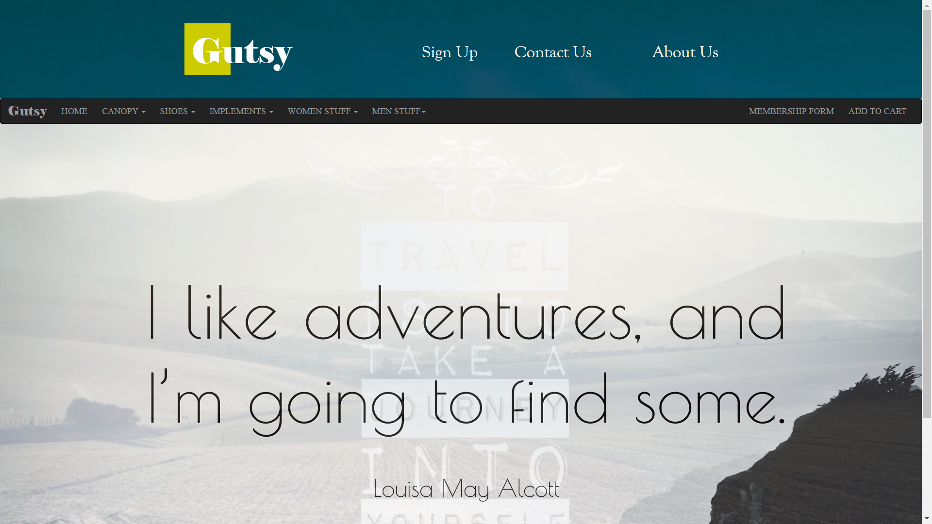


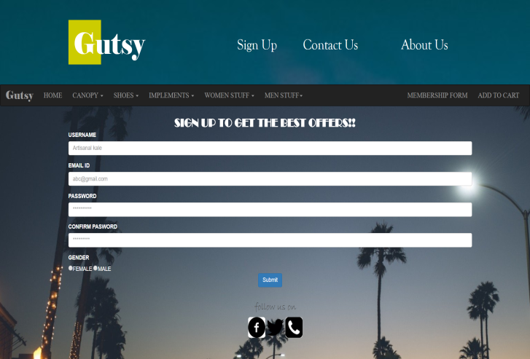
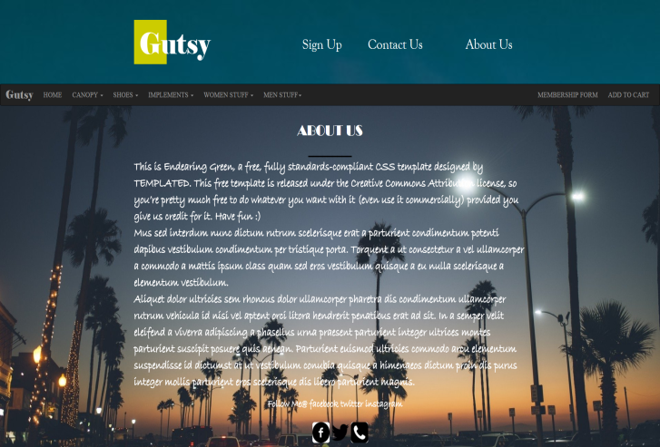
Previous Projects
1.E-Commerce Website (Minor Project)

Slide 8
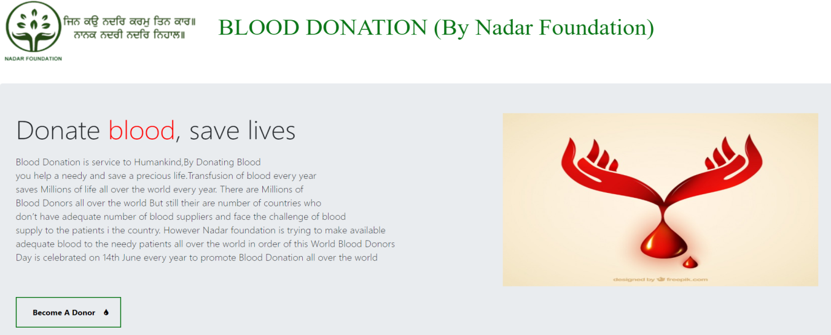
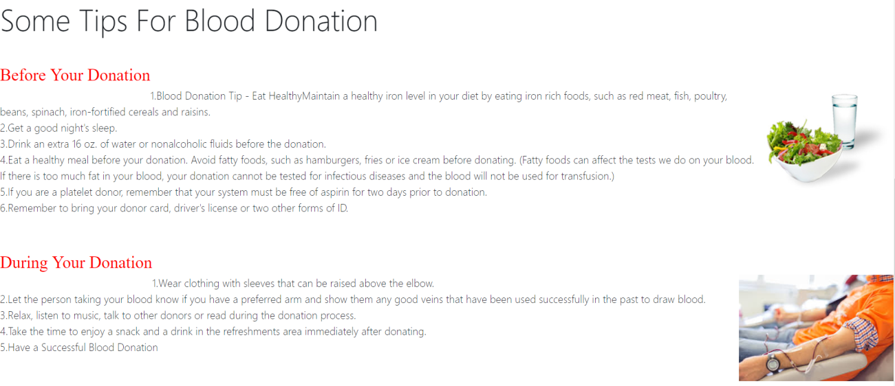
2. Nadar Foundation NGO website (additional pages to the existing website)
https://nandiniprashar.github.io/NGO/

Slide 9
Thank you…

